Slide 1
TEACHER CUE
CFU
HINT
Scaffolding for students
MAKE THE CONNECTION
Allow students to make the connection

Slide 2
Conduction is ________________________________
Convection is ________________________________
Radiation is __________________________________
Example of radiation:
Example of convection:
Example of conduction:

Slide 3
Sound is a _______________ wave
Light is a ________________ wave
_____________ travels faster than _______________
______________ spectrum refers to radiation
________________ is the distance between two peaks on a wave
_________________ is the height of a peak on a wave
The higher the ____________ the louder the sound

Slide 4
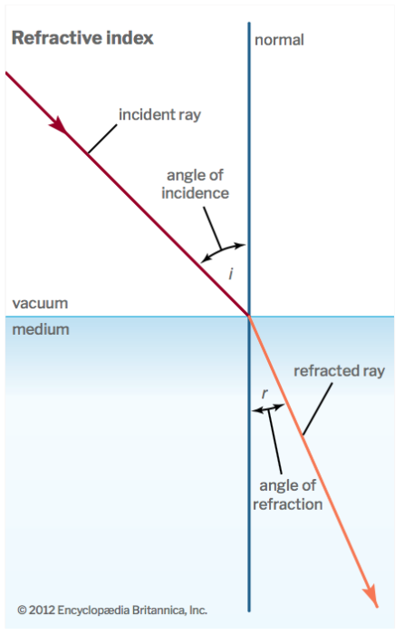
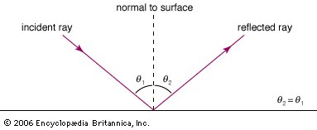
Reflection is when the ____________ angle is equal/not equal to the incident angle
Refraction is when the ____________ angle is not equal/equal to the ___________ angle

Slide 5
SWBAT describe how electricity is generated to power appliances
TRACK WITH ME
READ WITH ME
I can describe the process how electricity is made from a source of energy into powering appliances in the home.

Slide 6
SWBAT describe how electricity is generated to power appliances
What are the different forms of electricity?
Does anyone know how this energy is generated?

Slide 7
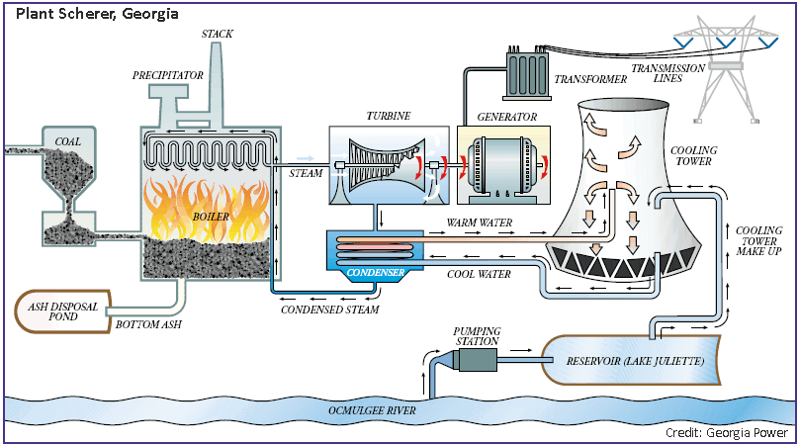

Slide 8

SWBAT describe how electricity is generated to power appliances
The first step in creating electricity is to find a form of energy.
Brainstorm in pairs what sources of energy can be used in electrical generation.
End

Slide 9
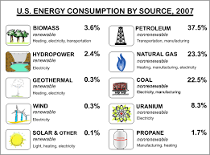
SWBAT describe how electricity is generated to power appliances

Slide 10

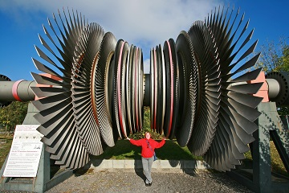
SWBAT describe how electricity is generated to power appliances
With almost all forms of energy the mechanical energy produced is used to turn a turbine.
The turbine is connected to a generator and the spinning of the turbine rotates the shaft connected to the generator
TEACHER CUE
Solar panels bypass this stage and create a flow of electrons without needing a turbine or generator

Slide 11
SWBAT describe how electricity is generated to power appliances
A generator transforms mechanical energy into electrical energy.
The shaft connected to the generator spins a magnet near a coil, creating a flow of electrons. This creates an alternating current (AC).

Slide 12
SWBAT describe how electricity is generated to power appliances
A generator creates a voltage difference between the two ends. This then causes electric charges to flow therefore generating an electric current.

Slide 14
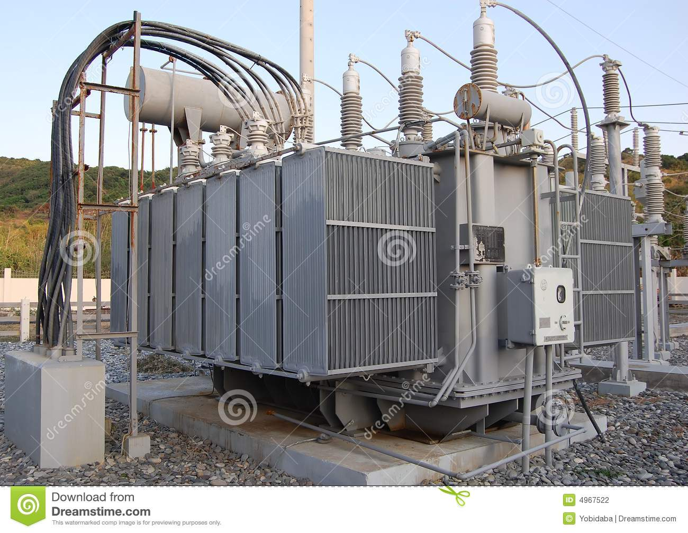
SWBAT describe how electricity is generated to power appliances
Transformer
Electricity loses its energy as it travels along wires. However high voltage electricity loses less energy so it is stepped up and made into higher voltage.

Slide 15
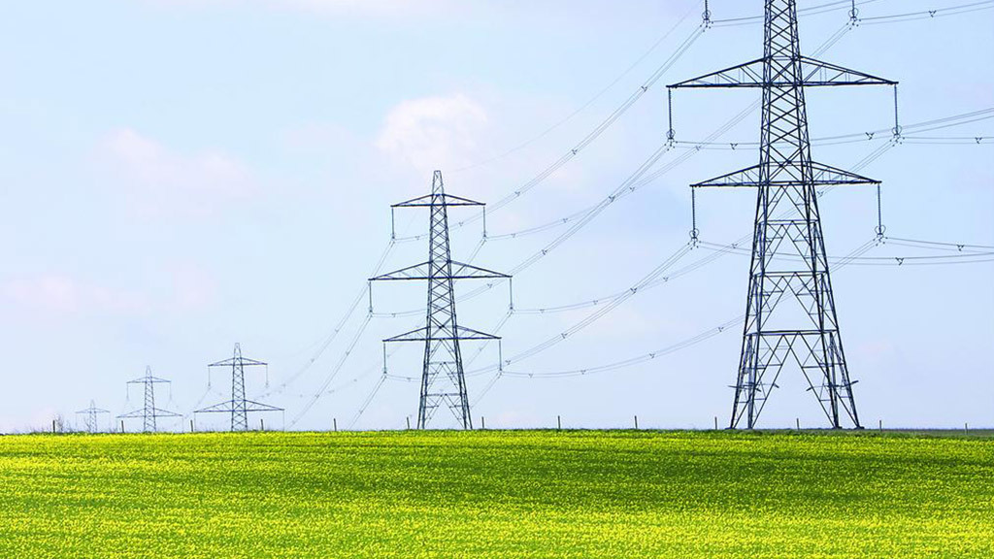
SWBAT describe how electricity is generated to power appliances
These are called pylons, which carry high voltage electricity over long distances to where it is needed, for example homes and industry.

Slide 16
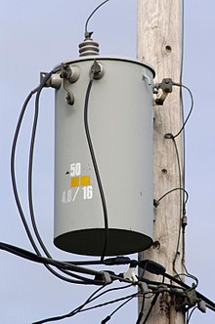
SWBAT describe how electricity is generated to power appliances
Have you ever seen one of these?
What would happen if you received electricity at high voltages in your home?
This is a step down transformer

Slide 17
SWBAT describe how electricity is generated to power appliances
TEACHER CUE
CFU
Based on what we have been discussing we are creating posters on the generation of electricity.
You can do this in groups (no more than 3).
Draw the stages of a power plant and then at each stage describe what occurs.

Slide 18
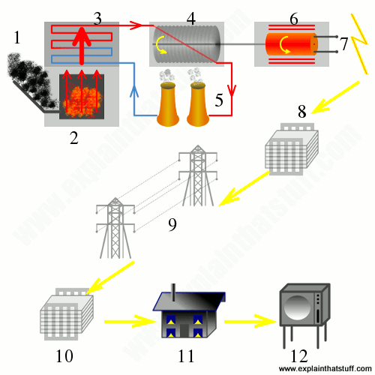
SWBAT describe how electricity is generated to power appliances

Slide 19
SWBAT describe how electricity is generated to power appliances
TRACK WITH ME
READ WITH ME
I can describe the process how electricity is made from a source of energy into powering appliances in the home.

